Slide 1


Laura Barrow
Lola Newell
Mehrun-nasa Hejazi
Moses Kinganga

Slide 2
Elevator Pitch / Concept
AS A user I WANT to be able to search for books and add them to my library with the option to delete them from the library and add them to certain shelves of my choice.
Bookify is the ultimate react app for book lovers! We created bookify because we believe that everyone deserved an easy and fun way to manage their personal library. Bookify allows you to search and add your favourite books to your personalised library, with our effortless drag and drop feature. There is no more fumbling with physical books, or complicated apps. Bookify simplifies the process so you can focus on what matters most. Reading!

Slide 3
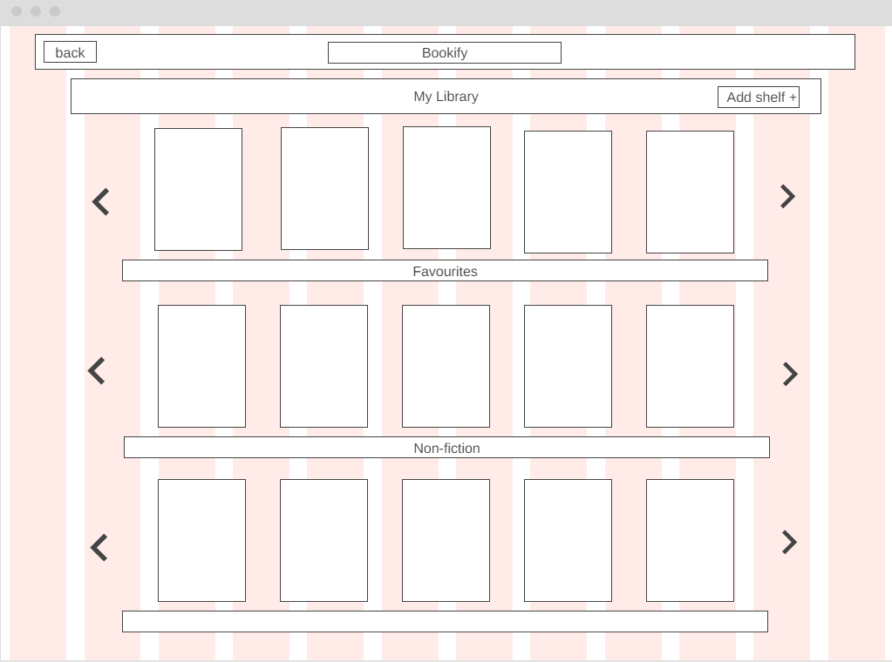

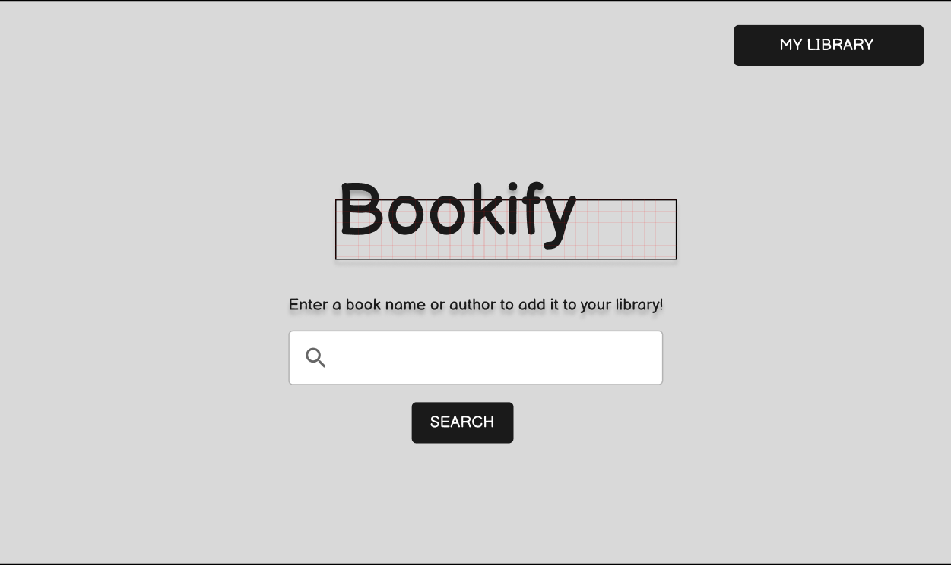


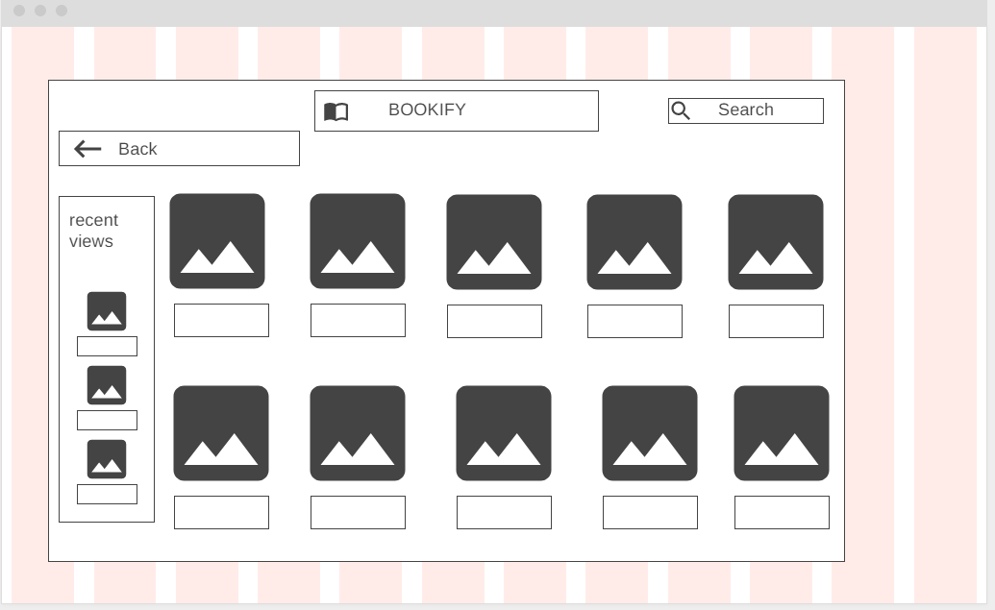

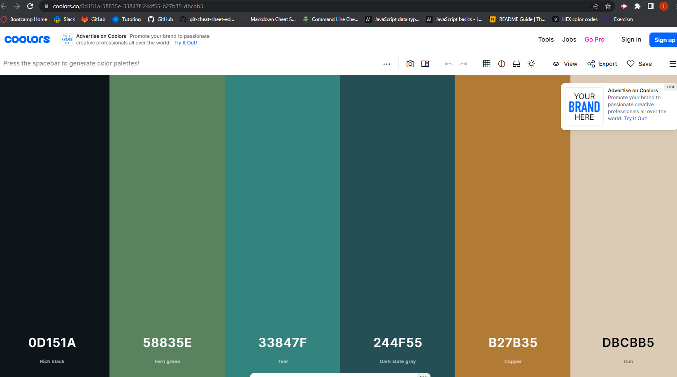

Process
Our project journey kicked off with Wireframing the 3 views across the 2 pages, setting out how we wanted our app to look. We incorporated a number of technologies/ libraries shown below within our code, and called the Google Books API to display the results following a user input. Once our logo was created, we were able to utilise coolors.co to create a personalised HEX colour palette for our app.
Technologies used..
Wireframing & Colour Palette..
Notes:
Material UI
Styled Components
@hello-pangea/dnd (React-beautiful-dnd)
React - useState, useEffect, UseRef, router, routerLink - useState, useEffect, UseRef, router, routerLink
Google Books API

Slide 4
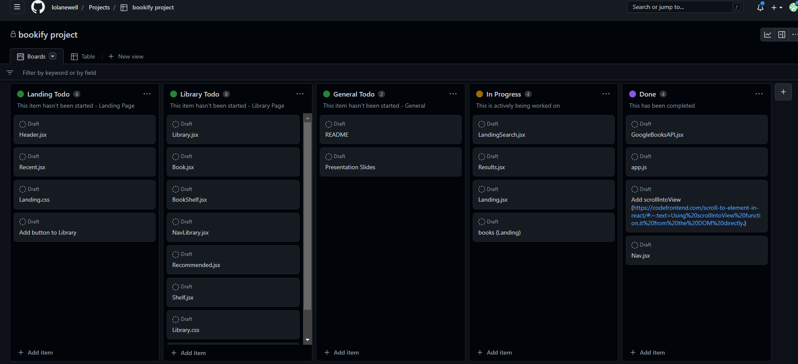
Process (cont.)
Challenges…
Utalising libraries is where we experienced most of our issues…
Implementing the ‘drag and drop’ feature which required us to come away from the documentation to fit it to our project.
Challenges with the NavBar to make it responsive.
Successes…
Collaborative working to overcome issues, as a team we worked well together.
Incorporating the drag and drop feature. Although it was challenging, it was a great success to get it working as expected!
We utalised the project boards within GitHub to breakdown our tasks, and understand our priorities for that day.
For the most part, the team worked collaboratively to share ideas, and all members took a lead on individual tasks.
GitHub Project Board..
Notes:
Material UI
Styled Components
@hello-pangea/dnd (React-beautiful-dnd)
React - useState, useEffect, UseRef, router, routerLink - useState, useEffect, UseRef, router, routerLink
Google Books API

Slide 5
Demo

Slide 6
Directions for Future Development
As we look towards the future of Bookify, we want to focus on a few key areas:
Expanding our book collection and improving the reading experience for our users. In addition to expanding our library, we want to implement a reading experience for our users. This could come with new feature such as highlighting, note-taking and bookmarking.
We also plan on exploring ways to increase the size of the text and the font to suit the user giving them a user experience such as dyslexia friendly.
Overall, our goal is to make bookify the go-to app for book lovers around the world, by meeting their needs and exceed their expectations.

Slide 7
Links
https://main--prismatic-manatee-5bddd1.netlify.app
https://github.com/lolanewell/bookify

